Slide 1

MLOps using MLFlow
Ashish Patel
Chief Data Scientist at IBM
Book author of Hands-On Time Series Analysis with Python
Notes:
Good morning/afternoon everyone, and welcome to our presentation on MLOps using MLFlow.
My name is Ashish Patel, and I am a Sr. AWS AI ML Solution Architect and Chief Data Scientist at IBM. I am also the author of the book "Hands-On Time Series Analysis with Python."
Today, we will be exploring the latest advancements in MLOps and how MLFlow can help streamline the development and deployment of machine learning models.
I am excited to share my knowledge and experience with you all and engage in a productive discussion.
So, sit back, relax, and let's dive into the world of MLOps and MLFlow. Thank you for being here today.

Slide 2
AGENDA
Session:1
MLOps – Processes and Stages
Challenges
MLFlow – Components
Mapping with MLOps Stages
Session:2
Demo – Real-world Example for MLFlow
Notes:
Great! Our agenda for today's presentation is split into two sections:
Session 1: In this session, we will cover the following topics:
MLOps – Processes and Stages
Challenges in MLOps
MLFlow – Components and its functions
Mapping MLFlow with the stages of MLOps
Session 2: In this session, we will have a hands-on demonstration of MLFlow in a real-world scenario.
This session will give you a clear idea of how MLFlow can be implemented in solving day-to-day challenges in MLOps.
So, let's get started with the first session and understand the fundamentals of MLOps and MLFlow. I am looking forward to an interactive and informative session with all of you."

Slide 3


Why?
Notes:
Imagine you visit your doctor for a routine check-up. Your doctor examines you and tells you that according to their medical report, you are male and you are pregnant. You are stunned and shocked because you know that this is not possible. You immediately realize that there is something wrong with the medical model being used to analyze your health.
Now, let's take another scenario, where a woman visits the doctor for a check-up and she is told that she is overweight, even though she is not. This type of situation can lead to incorrect diagnoses and treatments, which can have serious consequences for the patient.
This is where MLOps comes into play. MLOps is the process of integrating machine learning models into the overall software development lifecycle, which includes deployment, monitoring, and maintenance. By implementing MLOps, organizations can ensure that their machine learning models are accurate, reliable, and up-to-date.
Going back to the scenario of incorrect medical reports, the problem is not just limited to a single instance, it can have far-reaching effects and impact the overall healthcare system. For example, if a large number of patients receive incorrect diagnoses, it can lead to misallocation of resources, wasted time, and even harm to the patients.
This highlights the importance of MLOps in the healthcare industry and its ability to prevent such errors from happening. By implementing MLOps, healthcare organizations can ensure that their machine learning models are thoroughly tested, validated, and deployed in a controlled manner. This will result in accurate diagnoses and better patient outcomes.
In summary, MLOps helps organizations to ensure that their machine learning models are reliable and accurate, and it plays a crucial role in preventing situations like the ones mentioned above. By implementing MLOps, organizations can avoid costly errors and improve the overall quality of their machine learning systems
In conclusion, MLOps is critical for ensuring that machine learning models are delivering accurate results and avoiding situations like the ones mentioned above. With MLOps, organizations can ensure that their models are fit for purpose, secure, scalable, and continuously improved over time.

Slide 4
Challenges
Reproducibility in ML Models
ML Operations
Model Management
Tools and Technologies
Notes:
Picture this, you are a data scientist working on a critical machine learning project for your organization. You have spent countless hours training and fine-tuning your model, and finally, it is ready for deployment. You hand over the code and the model to the deployment team, and to your surprise, the model is not working as expected in the production environment.
This scenario highlights one of the major challenges in MLOps - reproducibility in ML models. Ensuring that the same results are obtained every time the model is run is critical for machine learning models to be deployed in a production environment. However, this is easier said than done.
Another challenge in MLOps is the operationalization of machine learning models. This involves deploying, monitoring, and maintaining the models in a production environment. This can be a complex process that requires specialized knowledge and resources.
Managing the lifecycle of machine learning models is also a major challenge in MLOps. This includes tracking the versions of the models, monitoring their performance, and retiring outdated models.
Finally, the rapid pace of technological change in the field of machine learning can make it difficult for organizations to keep up with the latest tools and technologies. Keeping track of new tools and technologies, and selecting the right ones for a particular use case, can be a challenge in itself.
In conclusion, MLOps is a complex field that faces a range of challenges, including reproducibility in ML models, operationalization of machine learning models, model management, and keeping up with the latest tools and technologies. Overcoming these challenges is critical for organizations to successfully deploy and maintain machine learning models in a production environment.

Slide 5
MLOps
Software Engineering
Write
DevOps
Deploy
ML Engineer
Training
How we write software
Software took months to release; now it releases daily.
How we use data + maths to train models
From curve fitting to neural networks…
MLOPS
How we Deploy Software
Evolution of Software Engineering from punch card to Distributed version control… GitHub!
Notes:
Imagine you are a software engineer who has just landed a job at a cutting-edge technology company. You are eager to learn about the latest software development practices and you are amazed at how much has changed in just a few years. Gone are the days when software took months to release; now it is released daily.
This is where DevOps comes in. DevOps is the combination of software development and IT operations, which focuses on continuous delivery and deployment of software. It has revolutionized the way software is deployed, making it possible to release new features and fixes on a daily basis.
But software development has changed even further with the rise of machine learning. Today, machine learning models are at the core of many applications, and they require a different set of skills and techniques to develop and deploy.
This is where MLOps comes in. MLOps is the combination of software engineering, DevOps, and machine learning engineering. It is the process of integrating machine learning models into the overall software development lifecycle, which includes deployment, monitoring, and maintenance.
In conclusion, MLOps is a cutting-edge field that combines the best of software engineering, DevOps, and machine learning engineering. It enables organizations to develop, deploy, and maintain machine learning models in a fast and efficient manner, driving innovation and transforming the way we work with data and machines."

Slide 6


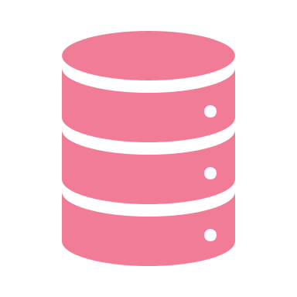


Collaboration in Nature
Data Pipeline
Modeling Pipeline
PREPARE DATA
TRAIN MODEL
Data Scientist
Data Repository
FEATURE
TRAIN
EVALUATE
RELEASE PIPELINE
RELEASE MODEL
Model Registry
Data
Engineer
DEPLOY
APPROVE
PROFILE
VALIDATE
PACKAGE
ML Engineer
Data Source
Notes:
Imagine you are working on a team of data scientists, data engineers, and ML engineers. You are all working together on a critical machine learning project that has the potential to revolutionize your organization. The project is complex and requires a great deal of collaboration and coordination.
The first step in the project is the data pipeline, which is the responsibility of the data engineer. The data engineer is tasked with preparing the data and storing it in a repository. This includes sourcing the data from various sources, cleaning and transforming the data, and ensuring that it is in the right format for modeling.
Once the data is ready, it is passed on to the data scientist who is responsible for the modeling pipeline. The data scientist uses the data to train a machine learning model, which involves feature engineering, training, and evaluating the model. The data scientist then stores the results of the model in a model registry for future reference.
Finally, the ML engineer is responsible for the release pipeline. This includes packaging the model, validating it, profiling it, and deploying it. The ML engineer also has the final say in whether the model is approved for deployment or not.
In conclusion, the success of a machine learning project depends on collaboration and coordination among the different teams involved. The data pipeline, modeling pipeline, and release pipeline are all critical components of MLOps, and each team plays a critical role in ensuring that the project is successful. By working together, the data scientist, data engineer, and ML engineer can transform the data into a machine learning model that is ready for deployment in a production environment

Slide 7


MLOps Life Cycle
ML Orchestration
ML Health
Business Impact
Model Governance
CI/CD
Data Pipeline
Machine learning
Models
Collaboration
Modeling Pipeline
Business Value
MLOps
Productionizing
Machine Learning
Models
Collaboration
Notes:
MLOps is the process of productionizing machine learning models, and it involves a series of steps that ensure that the model is properly integrated into the overall software development lifecycle. The MLOps life cycle includes five key stages: ML orchestration, ML health, business impact, model governance, and CI/CD.
ML Orchestration: Collaboration is at the heart of MLOps, and ML orchestration is the first stage in the life cycle. This stage involves the collaboration between the data engineer, data scientist, and ML engineer to ensure that the data pipeline, modeling pipeline, and release pipeline are properly integrated. The goal of ML orchestration is to ensure that the machine learning models are properly integrated into the overall software development lifecycle, so that they can be deployed, monitored, and maintained in a fast and efficient manner.
ML Health: Business values are at the center of MLOps, and ML health is the stage that focuses on ensuring that the machine learning models are delivering business value. This stage involves monitoring the machine learning models to ensure that they are performing as expected, and that they are delivering the desired business outcomes. If the models are not performing as expected, this stage includes identifying the root cause and taking the necessary steps to resolve the issue.
Business Impact: Once the machine learning models are delivering business value, the next stage is to measure and understand the business impact of the models. This stage involves tracking the key metrics that are associated with the business outcomes that the models are delivering, such as increased efficiency, reduced costs, or improved customer satisfaction. This information is then used to evaluate the success of the models and to make decisions about future investments in machine learning.
Model Governance: Collaboration is also critical in model governance, which is the stage that focuses on ensuring that the machine learning models are properly governed. This stage involves defining policies and procedures for the development, deployment, and maintenance of machine learning models, and ensuring that the models are aligned with the organization's goals and objectives. It also includes ensuring that the models are compliant with data privacy and security regulations.
CI/CD for Machine Learning Models: The final stage in the MLOps life cycle is CI/CD for machine learning models. This stage involves automating the deployment, monitoring, and maintenance of the machine learning models, and integrating them into the overall software development lifecycle. The goal of CI/CD for machine learning models is to ensure that the models are deployed, monitored, and maintained in a fast and efficient manner, while also ensuring that they are delivering business value.
In conclusion, the MLOps life cycle is a critical component of productionizing machine learning models. By following the five stages of the life cycle, organizations can ensure that their machine learning models are properly integrated into the overall software development lifecycle, that they are delivering business value, and that they are properly governed. By doing so, organizations can drive innovation and transform the way they work with data and machines.

Slide 8
Life Cycle
Coding
Commit
Test Release
Unit Test Cases
Peer Review
Approval
Prod Release
Writing Code for specific requirements/functionality
Writing Unit test cases for each functionality and block to cover all boundary condition
Peer review the code and make sure code meets the standard and best practices
Code is approved to check-in to repository / version control
Approved code is merged with main / feature branch for release rollover
Release the feature / main branch for Testing.
Move the Tested version to production.
Notes:
The life cycle of a software development project involves several stages to ensure that the code is well-written, thoroughly tested, and ready for release to production. This is a crucial aspect of software development as it helps to minimize the risk of bugs, improve the quality of the code, and increase its reliability.
Coding: The first stage of the life cycle is writing code to meet specific requirements and functionality.
Unit Test Cases: The second stage is writing unit test cases to cover all boundary conditions for each block of code and functionality. This stage helps to identify and resolve any issues before the code is submitted for review.
Peer Review: After the code has been written and tested, it is then reviewed by peers to ensure it meets the standards and best practices of the development team. This stage is an opportunity to catch any issues early on and to receive feedback on the code.
Approval: Once the code has been reviewed, it is approved to be checked-in to the repository or version control system.
Commit: The approved code is then merged with the main or feature branch for the release rollover.
Test Release: The feature or main branch is then released for testing to ensure that it works as intended.
Prod Release: If the testing is successful, the version is then moved to production for use by the end-users.
This life cycle process is an important aspect of software development as it helps to ensure that the code is reliable and meets the needs of the business.

Slide 9
Life Cycle
Software
ML
GOAL
Coding
Analyse Data
Cover Functional
Requirements
Optimization Metrics
Unit Test Cases
Data Preparation
QUALITY
Peer-Review
Depends on the code
Depends on Data, choice of
Algorithms, params, etc.
Building Model
Approval
TECHNOLOGY
Evaluate the Model
Mostly one tech stack
Combinations of Many
Libraries and tools
Commit
Model Optimization
Test Release
OUTCOME
Deploy Model
Works deterministically
Changing based on Data
Prod Release
Monitor and Re-train
Notes:
The life cycle of an ML project involves several stages that must be completed before deploying a machine learning model. It starts with data analysis, which involves understanding the data, identifying any problems or issues, and creating a plan for how to best use it for modeling.
Data preparation is then necessary, which involves cleaning and transforming the data, and creating a suitable format for the model. Building the model is the next step, which involves selecting the appropriate algorithms, training the model on the data, and evaluating its performance.
Model optimization is crucial, as it involves fine-tuning the parameters and algorithms to improve the model's performance. Once the model has been optimized, it can be deployed, which involves integrating it into a production environment and making it available for use.
The final step is monitoring and retraining, which involves ongoing monitoring of the model's performance and updating it as needed. The goal of the ML part of the life cycle is to optimize the metrics, while ensuring quality and utilizing a combination of different libraries and tools.
On the other hand, the software part of the life cycle focuses on fulfilling functional requirements, with a focus on quality that depends on the code and technology that mostly utilizes one tech stack. This part works deterministically, meaning that the outcome is predictable.
The combination of both the software and ML parts of the life cycle is critical to ensuring the success of an ML project, as it enables collaboration between software engineers and data scientists and helps to create a solution that is efficient and effective. Imagine a software development company with a team of software engineers, data scientists, and ML engineers. The company is developing a new product that involves both traditional software development and machine learning. The team must have four main goals in mind to ensure the success of the product:
Goal: The first goal is to cover functional requirements for the software and optimization metrics for the machine learning models. The software must fulfill the requirements specified by the client or stakeholders, while the machine learning models must be optimized for the best results.
Quality: The quality of the software depends on the code written by the software engineers. Proper coding practices and adherence to coding standards are essential for ensuring the quality of the software. On the other hand, the quality of the machine learning models depends on the data, choice of algorithms, and parameters used in the models. Data scientists and ML engineers must carefully select and prepare the data, choose appropriate algorithms, and tune the parameters to ensure the quality of the models.
Technology: Software development typically involves one technology stack, such as Java or Python, while machine learning involves the use of many libraries and tools. Data scientists and ML engineers must be familiar with the latest machine learning libraries and tools and have the ability to use them effectively to develop high-quality models.
Outcome: Software works deterministically, meaning that given the same inputs, the software will always produce the same outputs. Machine learning, on the other hand, is different. The outcome of a machine learning model depends on the data it was trained on and is subject to change based on the new data it receives. This makes the deployment and maintenance of machine learning models a complex process, requiring close collaboration between software engineers, data scientists, and ML engineers.
In conclusion, the team must keep these four goals in mind when developing a product that involves both software development and machine learning. Proper collaboration, technology selection, and quality assurance processes are crucial for ensuring the success of the product.

Slide 10

A platform for the Complete Machine Learning Lifecycle
Notes:
MLFlow, developed by Databricks, is a platform for the complete machine learning lifecycle. It was created to address the challenges faced by data scientists and machine learning engineers in managing the end-to-end machine learning process. The platform aimed to simplify the complex processes involved in machine learning and provide a centralized and organized solution to manage models from development to deployment.
The idea of MLFlow started from the need for a solution that could help data scientists in keeping track of the experimentation process and model versioning. With the increasing demand for machine learning models in various industries, the need for a comprehensive platform to manage the machine learning lifecycle was pressing.
Databricks recognized the need for a platform that could bring together all the pieces of the machine learning puzzle and make the process of building and deploying models easier. That's how MLFlow was born. It was designed to be an open-source platform that could be used by anyone, from data scientists to machine learning engineers, to manage the complete machine learning lifecycle.
MLFlow has quickly become the go-to platform for managing the end-to-end machine learning process. It is widely adopted by organizations of all sizes and has become an essential tool for data scientists and machine learning engineers to manage their models. With MLFlow, data scientists can experiment with different algorithms, keep track of experiments, and manage models in a centralized and organized manner.
In conclusion, MLFlow is a game-changer in the machine learning world. It has made the process of building and deploying machine learning models much easier and has become an essential tool for data scientists and machine learning engineers. With MLFlow, organizations can now manage their machine learning models with ease and ensure that their models are reliable and accurate.

Slide 11
MLFlow Components
MLFlow
MLFlow Tracking
MLFlow Projects
MLFlow Models
MLFlow Registry
Record and query experiments: code, data, config, and results
Store, Annotate, Discover and Manage
Models in central repository
Package data science code in format to reproduce runs on any platform
Deploy machine learning models in diverse serving environments
Notes:
Once upon a time, in the field of machine learning, the process of managing and deploying models was a complex and disjointed task. Teams struggled with tracking experiments, packaging code, and deploying models in a consistent manner. The fragmentation of the process often led to difficulties in reproducibility, model governance, and collaboration among team members.
In response to these challenges, Databricks introduced MLFlow, a platform for the complete machine learning lifecycle. MLFlow is a central platform that provides a suite of components to manage the entire process of machine learning, from tracking experiments to deploying models.
The first component of MLFlow is Tracking. This component allows teams to record and query experiments, including code, data, configuration, and results. This provides a centralized location for teams to view and compare experiments, allowing for easier collaboration and better decision-making.
Next, MLFlow Projects provide a way to package data science code into a format that can be easily reproduced across any platform. This helps ensure that code remains consistent and can be used by other team members, even in different environments.
MLFlow Models provides the ability to deploy machine learning models in diverse serving environments, including cloud-based platforms, local machines, and on-premise hardware. This component helps teams to easily deploy models, no matter where they are running.
Finally, the MLFlow Registry component allows teams to store, annotate, discover, and manage models in a central repository. This component provides a centralized location for teams to store and access their models, making it easy to share and reuse models across different projects.
With MLFlow, teams can streamline the process of machine learning, reducing friction and improving collaboration. The platform is designed to be flexible, scalable, and easy to use, making it an essential tool for any machine learning project.

Slide 12
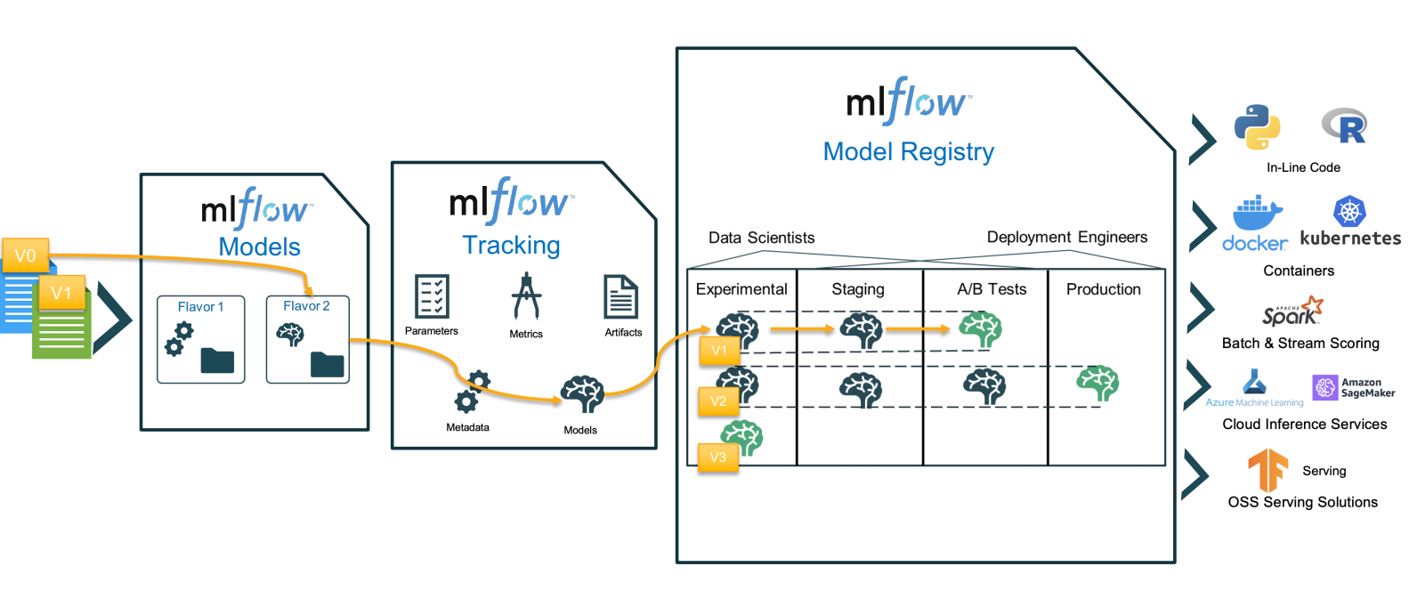
MLFlow Workflow
Notes:
The workflow of MLFlow begins with deploying machine learning models in diverse serving environments. MLFlow provides the flexibility to deploy models in various platforms, including cloud inference services, Azure ML and AWS Sagemaker, and open source serving solutions like Tensorflow serving. This allows organizations to choose the most suitable serving environment for their needs.
Once the models are deployed, the next step is to record and query experiments. This is where MLFlow Tracking comes into play. With MLFlow Tracking, data scientists can easily record experiments by logging code, data, configuration, and results. This allows them to keep track of all the experiments they have conducted and compare the results of different models.
Finally, MLFlow Registry is used to store, annotate, discover and manage models in a central repository. This is a critical component of the MLFlow platform, as it allows data scientists to share models with their colleagues and keep track of all the models they have created. With the ability to annotate models, data scientists can add additional information to their models, making it easier for others to understand the purpose and results of the models.
Overall, the MLFlow platform provides a complete solution for the machine learning lifecycle, from model deployment to model management. With the support of Python and R programming for inline code, and docker and kubernetes for orchestration, the platform is able to handle both batch and stream processing using Apache Spark.

Slide 13
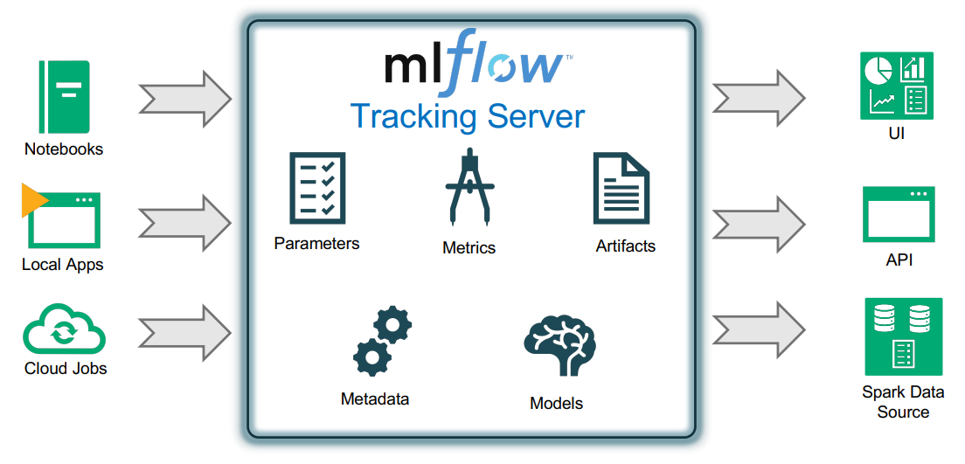
MLFlow Tracking
Notes:
MLFlow Tracking is an essential component of the MLFlow platform that provides a centralized and organized way to track and manage machine learning experiments. The main purpose of MLFlow Tracking is to record and query the different aspects of an experiment, such as code, data, configuration, and results. This information is stored in a tracking server that can be accessed through a user-friendly UI, APIs, and Spark data structures.
MLFlow Tracking integrates seamlessly with various sources of machine learning experiments, including Jupyter notebooks, local applications, and cloud jobs. This enables data scientists, machine learning engineers, and developers to easily track the progress and results of their experiments from a single location, providing them with a comprehensive view of their work and making it easier to compare different runs.
The tracking server also provides the ability to log important parameters, metrics, artifacts, metadata, and models, giving users the ability to easily compare and analyze different experiments. The recorded information can be used to optimize the machine learning models and improve the accuracy of predictions over time.
Overall, MLFlow Tracking is a powerful tool for the management and analysis of machine learning experiments, providing a centralized and organized way to track, compare, and optimize machine learning models.
Explain this in tracking server: parameters, metrics, artifacts, metadata, and models
MLFlow Tracking Server is a central repository that records the parameters, metrics, artifacts, metadata, and models of machine learning experiments. It allows data scientists, machine learning engineers, and other stakeholders to keep track of their machine learning models and experiments.
The tracking server provides a unified view of all the different experiments that were run and the results that were obtained from them.
This allows for easy comparison of results and identification of trends in the data.
The parameters recorded in the tracking server include the configuration settings used in each experiment, such as the type of algorithm used, the number of iterations, the learning rate, and more.
The parameters recorded in the tracking server include the configuration settings used in each experiment, such as the type of algorithm used, the number of iterations, the learning rate, and more.
Metrics recorded in the tracking server include performance metrics such as accuracy, precision, recall, and F1 score, that are generated as a result of each experiment.
Artifacts refer to the data, code, and other resources that are generated or used in each experiment. This can include raw data, pre-processed data, trained models, and more.
The metadata recorded in the tracking server include information such as the date and time of the experiment, the user who ran the experiment, and the experiment’s status.
Finally, the models recorded in the tracking server can be stored, annotated, discovered, and managed in a central repository, making it easier for stakeholders to collaborate and reproduce experiments.
The tracking server provides an interface for querying and visualizing the parameters, metrics, artifacts, metadata, and models of each experiment, making it easier to understand and compare the results of each experiment.
Finally, the models recorded in the tracking server can be stored, annotated, discovered, and managed in a central repository, making it easier for stakeholders to collaborate and reproduce experiments. The tracking server provides an interface for querying and visualizing the parameters, metrics, artifacts, metadata, and models of each experiment, making it easier to understand and compare the results of each experiment.

Slide 14
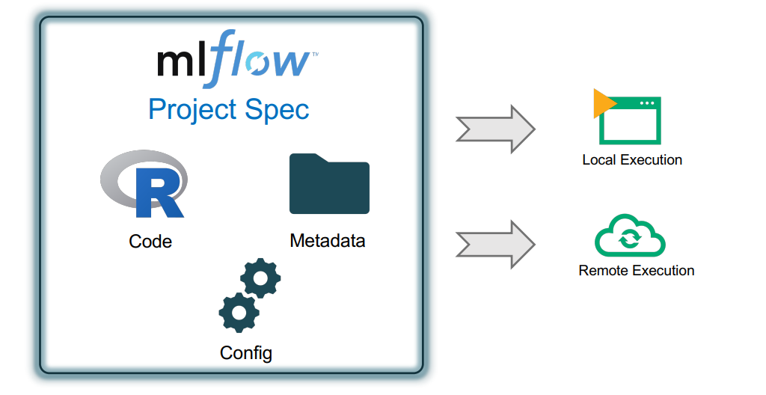
MLFlow Projects
Notes:
MLFlow Projects is a feature of the MLflow platform that enables data scientists and machine learning engineers to package their code and associated metadata and configuration into a format that can be easily reproduced on any platform. This helps ensure that machine learning models and their associated processes are reproducible and can be easily shared between teams and stakeholders.
The MLFlow Projects specification includes the code, metadata, and configuration necessary to run the project. This specification can be executed locally or remotely, depending on the needs of the project and the resources available.
Local execution refers to running the project on the local machine or a local cluster. This is useful for development and testing, as it allows data scientists to iterate quickly and make changes without the need for a remote cluster or cloud-based infrastructure.
Remote execution refers to running the project on a remote cluster or cloud-based infrastructure. This is useful for scaling the project to handle larger datasets, using more powerful computing resources, and deploying the project to production.
By using MLFlow Projects, data scientists and machine learning engineers can easily share their work, ensure reproducibility, and collaborate on complex machine learning projects. This helps accelerate the development and deployment of machine learning models and enables teams to focus on delivering business value.

Slide 15
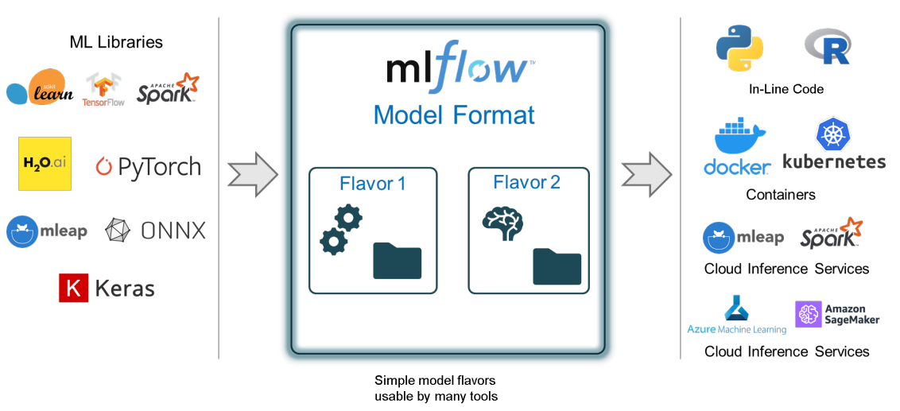
MLFlow Models
Notes:
MLFlow Models is a component of the MLFlow platform that enables the deployment of machine learning models in a diverse range of serving environments.
It supports a variety of machine learning libraries, including scikit-learn, TensorFlow, Spark, H2O.ai, PyTorch, MLeap, ONNX, and Keras.
The models can be deployed in local or remote environments, and can be run using a variety of tools and technologies, such as Python and R programming languages, Docker and Kubernetes for orchestration, Apache Spark for batch and stream processing, cloud inference services such as Azure ML and AWS Sagemaker, and TensorFlow serving for open source serving solutions.
MLFlow Models makes it easy to package and deploy machine learning models, allowing data scientists and machine learning engineers to focus on model development and optimization, without worrying about the deployment process.
In other words, MLflow Models make it easy to manage the lifecycle of your machine learning models. You can package your models in a standard format and use a variety of tools to deploy them to different environments for serving, batch processing, and inference. By supporting multiple "flavors", MLflow Models provide compatibility with a range of technologies, such as TensorFlow, scikit-learn, and Apache Spark, to name a few. Additionally, by tracking the parameters, artifacts, and metadata of your models, MLflow makes it easier to understand their history, reuse them, and compare results. This allows data scientists and engineers to collaborate more effectively and make data-driven decisions with confidence.

Slide 16
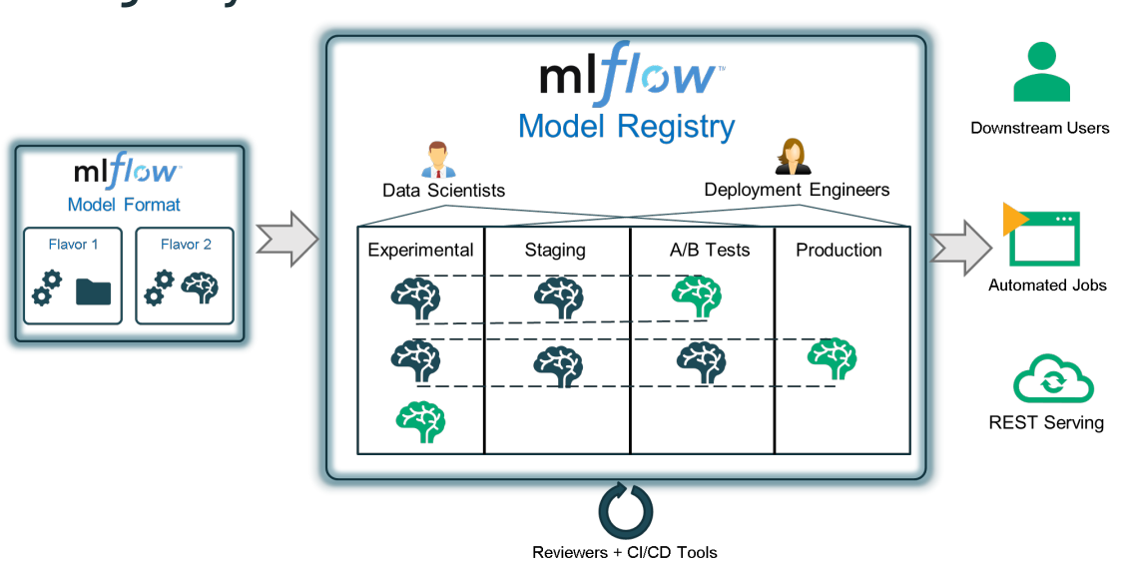
MLFlow Registry
Notes:
The MLflow Registry is a centralized platform for managing the lifecycle of machine learning models. It provides a set of APIs and a user-interface for tracking and managing the complete history of a model, from its creation to deployment and maintenance.
The Registry helps with model lineage, by keeping a record of which MLflow experiment and run produced the model. This information allows data scientists to trace the origin of a model and understand the context in which it was created.
In addition to lineage, the Registry provides model versioning, allowing data scientists to store multiple versions of a model and easily switch between them as needed. This is especially useful for A/B testing and for keeping track of changes made to the model over time.
The Registry also supports stage transitions, such as moving a model from a staging environment to production, or archiving it. This helps to manage the deployment and maintenance of models and ensure that they are being used correctly.
Finally, the Registry provides annotations, which allow data scientists to attach notes or metadata to models, such as descriptions, performance metrics, or usage guidelines. This information can be used to improve collaboration and model management within an organization.

Slide 17
Session 2
Demo – Real-world Example for MLFlow
Notes:
Welcome to Session 2 of the MLFlow workshop. Today, we will be diving into a real-world example of using MLFlow to manage a machine learning project. This demonstration will showcase the power and versatility of MLFlow in handling the end-to-end machine learning process. We will be covering how to use MLFlow to track experiments, package code into reproducible projects, deploy models to various serving environments, and store and manage models in a centralized repository. Get ready to see the practical applications of MLFlow in action!

Slide 18

Thank you

